Slide 1




NEXT GEN EMPLOYABILITY PROGRAM
Creating a future-ready workforce
Team Members
College Name
Student Name : Anusha
Student ID :721021104011
Nehru institute of technology
Coimbatore

Slide 2

Project Titlet Title
Notes Sharing Web Application using Django Framework
Abstract | Problem Statement | Project Overview | Proposed Solution | Technology Used | Modelling & Results | Conclusion

Slide 3
Abstract
In today's digital era, the demand for efficient and easily accessible educational resources is greater than ever. In response to this demand, a collaborative note sharing web application has been developed to facilitate the sharing of academic materials among students
. The application is designed to offer a robust platform for users to upload, download, and share notes in various formats. It utilizes Django, a high-level Python web framework that encourages rapid development and pragmatic design, to ensure scalability, ease of maintenance, and a clear separation of concerns through its Model-View-Template (MVT) architecture.
Key features of the application include user authentication, file management, search functionality for ease of access to specific materials, and a categorization system for organizing notes by subject, topic, or course. Preliminary testing has shown that the application has a user-friendly interface and has been well-received by the target audience, suggesting that it could significantly enhance the learning experience by promoting collaborative study and resource sharing.
Future work will focus on incorporating advanced features such as collaborative editing, integration with cloud storage services, and implementing machine learning algorithms to recommend personalized content to users based on their interests and study habits.
Source :Gpt 4

Slide 4
Problem Statement
One of the major issues that this project aims to solve is the lack of a platform that is intuitive, efficient, and collaborative, specifically designed for students and educators to share and manage academic notes and resources. Even though there are various online platforms available, there remains a significant gap in services that cater specifically to academic collaboration.
As a result, many students have to resort to fragmented and less secure means of sharing study materials. This project is focused on using the Django framework to develop a user-friendly, secure, and scalable web application. This application will not only facilitate the easy sharing and organization of notes but also enhance the overall learning experience through collaborative features and a community-driven approach.
Source :

Slide 5
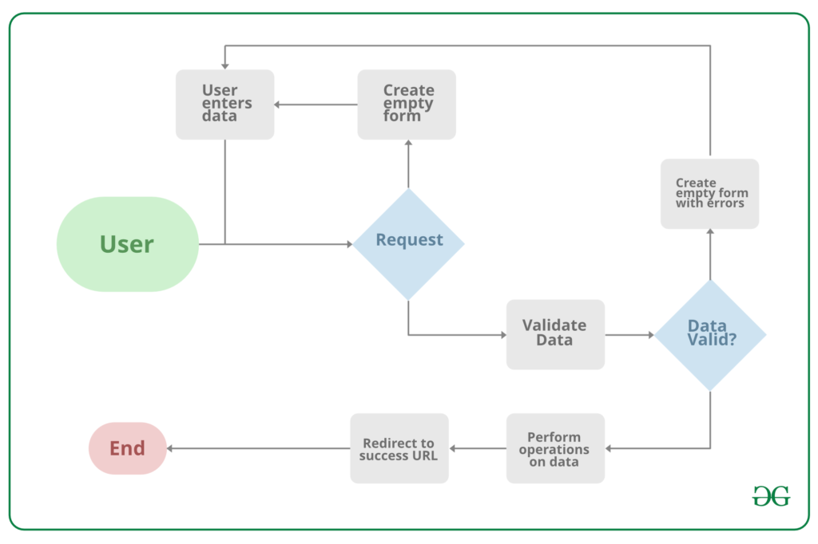
Project Overview
Source :google

Slide 6
Proposed Solution
The proposed solution is to develop a comprehensive, secure, and user-friendly Notes Sharing Web Application tailored for students, educators, and academic institutions. This application will leverage the Django framework for its robustness, security features, and scalability. Below are the key components of the proposed solution:
1. System Architecture
Backend Development: Utilize Django for server-side logic, database management, user authentication, and session management, ensuring a secure and efficient backend structure.
Frontend Integration: Employ HTML, CSS, and JavaScript, alongside Django’s template system, to create an intuitive and responsive user interface that enhances user experience.
Database Design: Design a relational database schema that efficiently stores user data, notes, categories, and interactions to facilitate quick retrieval and secure storage of information.
2. Core Features
User Authentication and Authorization: Implement Django’s built-in authentication system to manage user accounts, secure login/logout processes, and ensure user data privacy.
Notes Management: Enable users to upload, download, and manage notes in various formats (PDF, DOCX, PPT, etc.), with features for creating, editing, and deleting notes.
Collaboration Tools: Incorporate features for users to comment on notes, rate them, and engage in discussions, fostering a collaborative learning environment.
.
Source : GPT 4

Slide 7
3. Security and Privacy
Implement Django’s security best practices to protect against common vulnerabilities such as SQL injection, Cross-Site Scripting (XSS), and Cross-Site Request Forgery (CSRF).
Ensure data privacy by adhering to regulations such as GDPR for the handling of personal information.
4. Scalability and Performance
Design the application with scalability in mind, allowing for easy adaptation to increased user numbers and data volume without performance degradation.
Utilize Django’s caching framework to enhance application performance and reduce server load.
5. User Experience (UX) Design
Follow a user-centered design approach to create an accessible and engaging platform, ensuring that the UI/UX caters to the needs and preferences of the target audience.
Implement responsive design principles to ensure the application is accessible across various devices and screen sizes.
6. Testing and Quality Assurance
Conduct thorough testing, including unit tests, integration tests, and user acceptance testing (UAT), to ensure the application is reliable, secure, and user-friendly.
Utilize Django’s testing framework to automate test cases and ensure code integrity.
Source :GPT 4

Slide 8
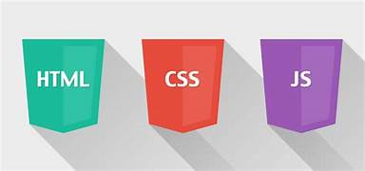

Technology Used
Front-end
Back-end
Source :

Slide 9
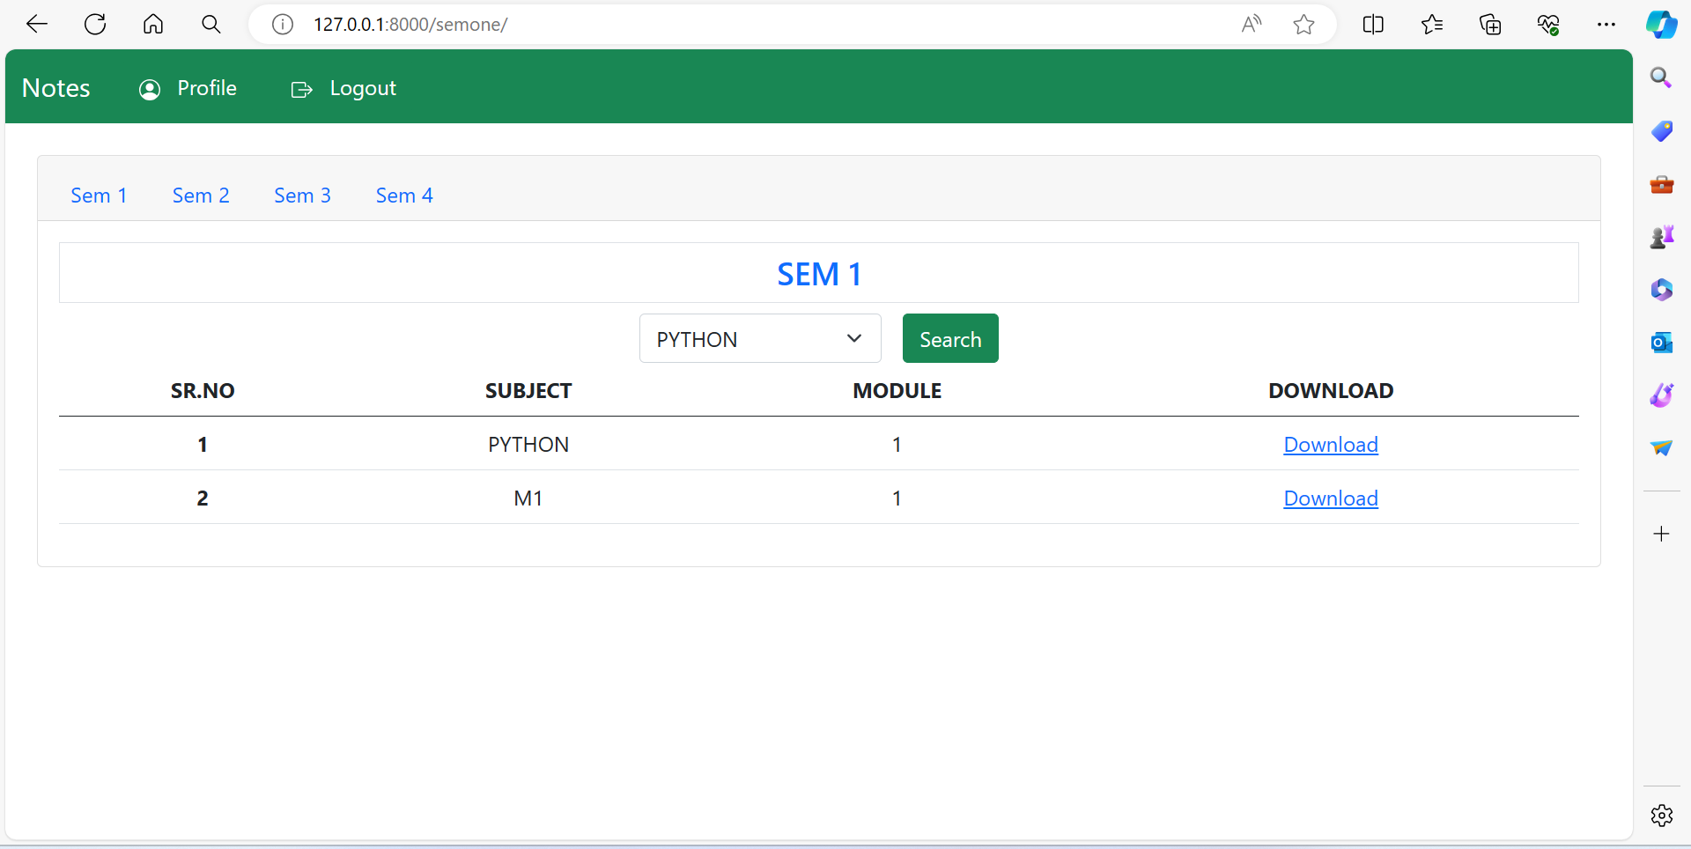
Modelling & Results
Source :

Slide 10
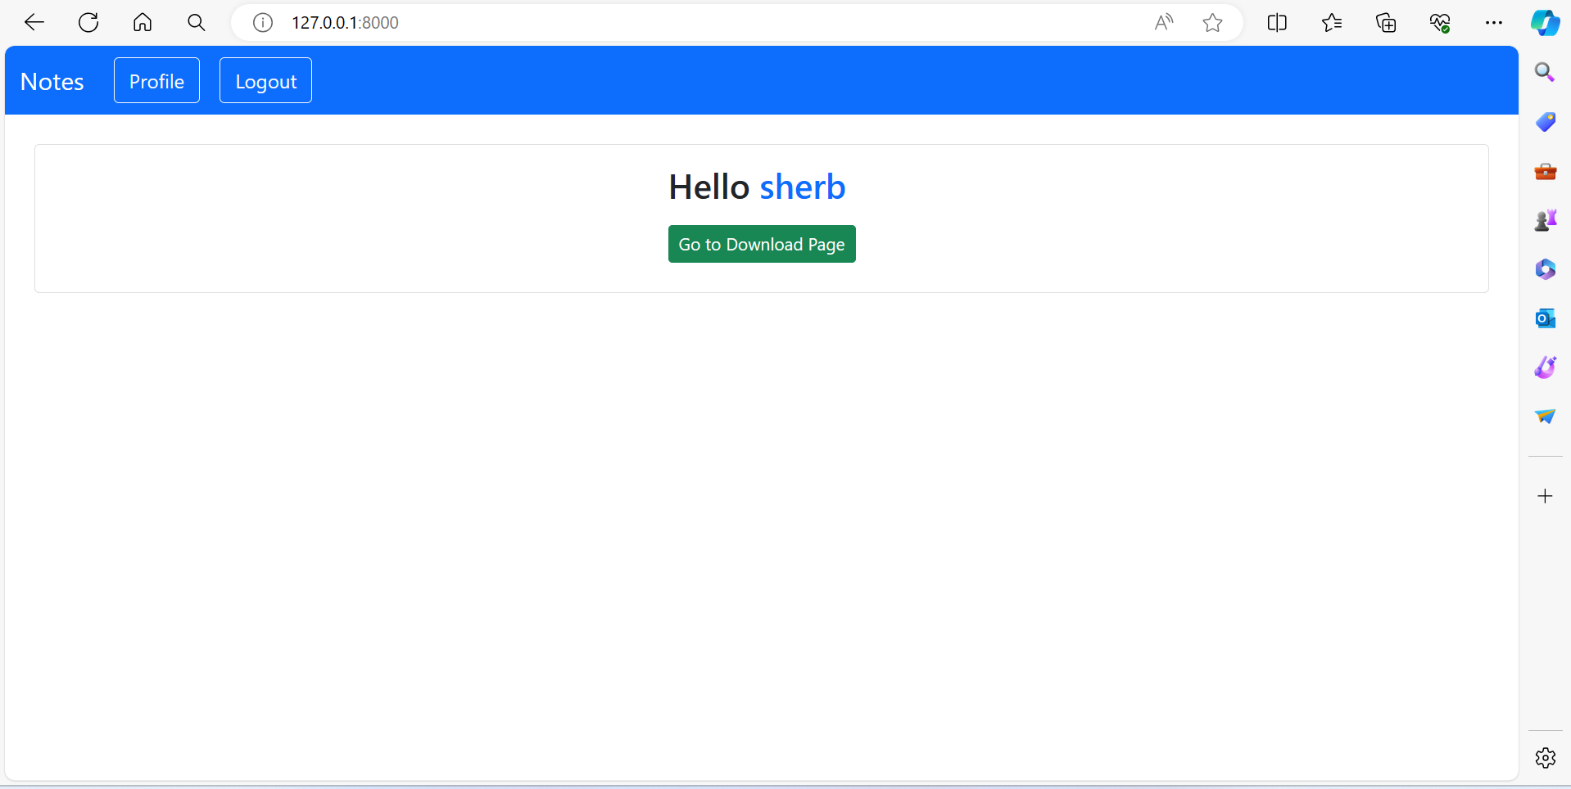
Homepage

Slide 11
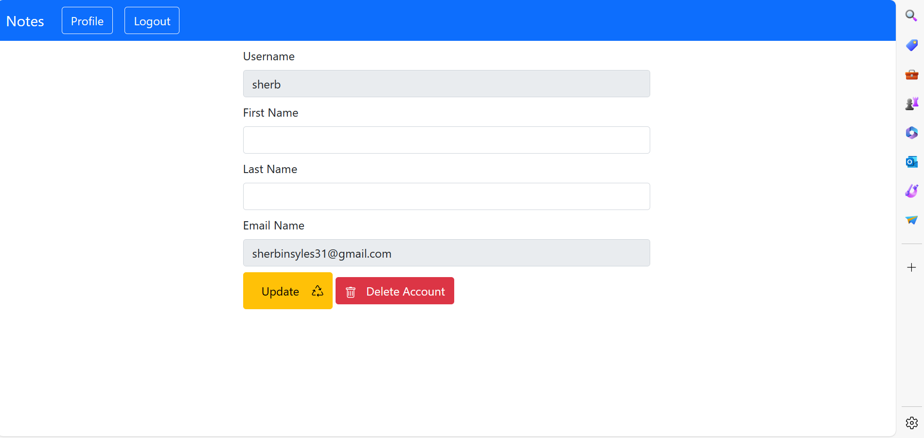
User-Profile

Slide 12
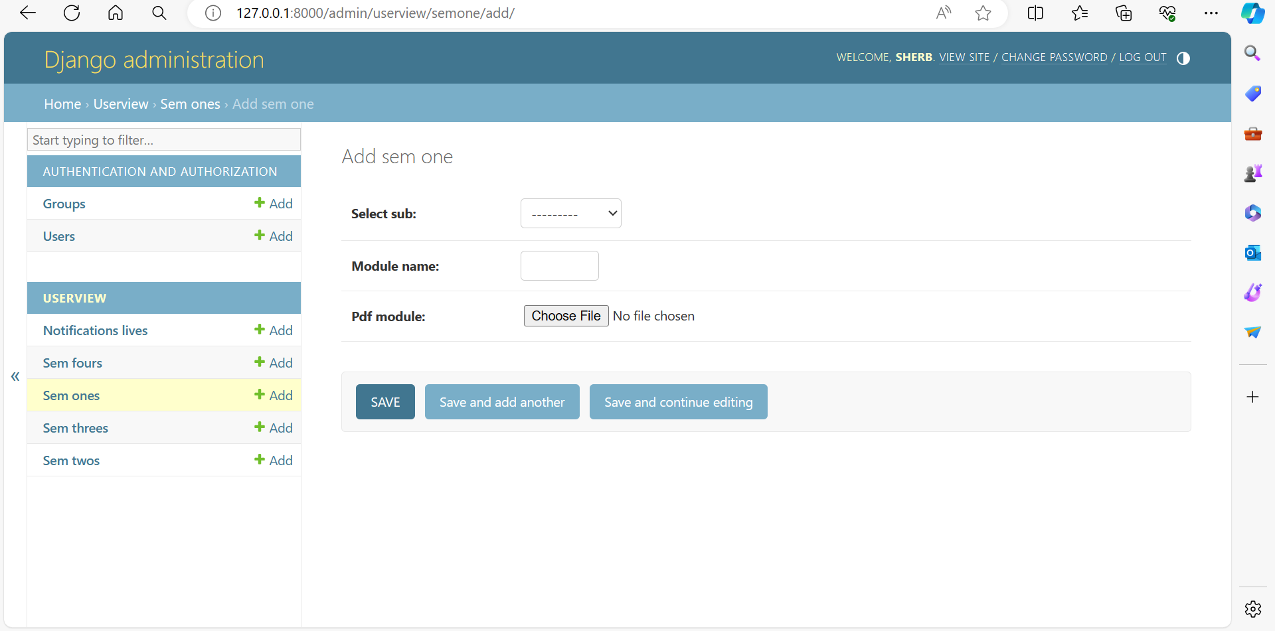
Admin-Page

Slide 13
Departments-Page

Slide 14
Future Enhancements:
The following are some proposed features for an educational application:
1. Integration of Artificial Intelligence and Machine Learning
- Content Recommendation System: The application will use machine learning algorithms to analyze user preferences, behavior, and interactions with the content. This will enable the app to provide personalized note recommendations to the users.
2. Enhanced Collaboration Features
- Real-Time Collaboration: The application will introduce real-time editing and commenting features. This will allow multiple users to work on the same document simultaneously, similar to Google Docs.
- Study Groups: The application will enable users to create and join study groups within it. This will foster a more organized and collaborative learning environment.
3. Integration with External Platforms
- Cloud Storage Services: The app will offer integration with cloud storage platforms (e.g., Google Drive, Dropbox). This will allow users to easily upload and backup their notes.

Slide 15
Conclusion
In conclusion, note sharing applications serve as versatile tools that facilitate collaboration, knowledge exchange, and organization across various domains. Whether utilized for educational purposes, professional endeavors, or personal organization, these platforms offer a centralized hub for users to create, share, and collaborate on notes. By promoting efficient communication, enhancing productivity, and fostering learning and growth, note sharing applications play a crucial role in empowering individuals, teams, and communities to connect, collaborate, and succeed in today's digital age. As technology continues to evolve, the significance and impact of note sharing applications are expected to grow, providing invaluable support for collaboration and knowledge sharing in diverse contexts.
Source :

Slide 16
Thank You!
Notes:
Thank You !!

